Slide 1


Learn to Code: Python
Timothy Hoang
Austin Hispanic Hackers
May 25th, 2021

Slide 2
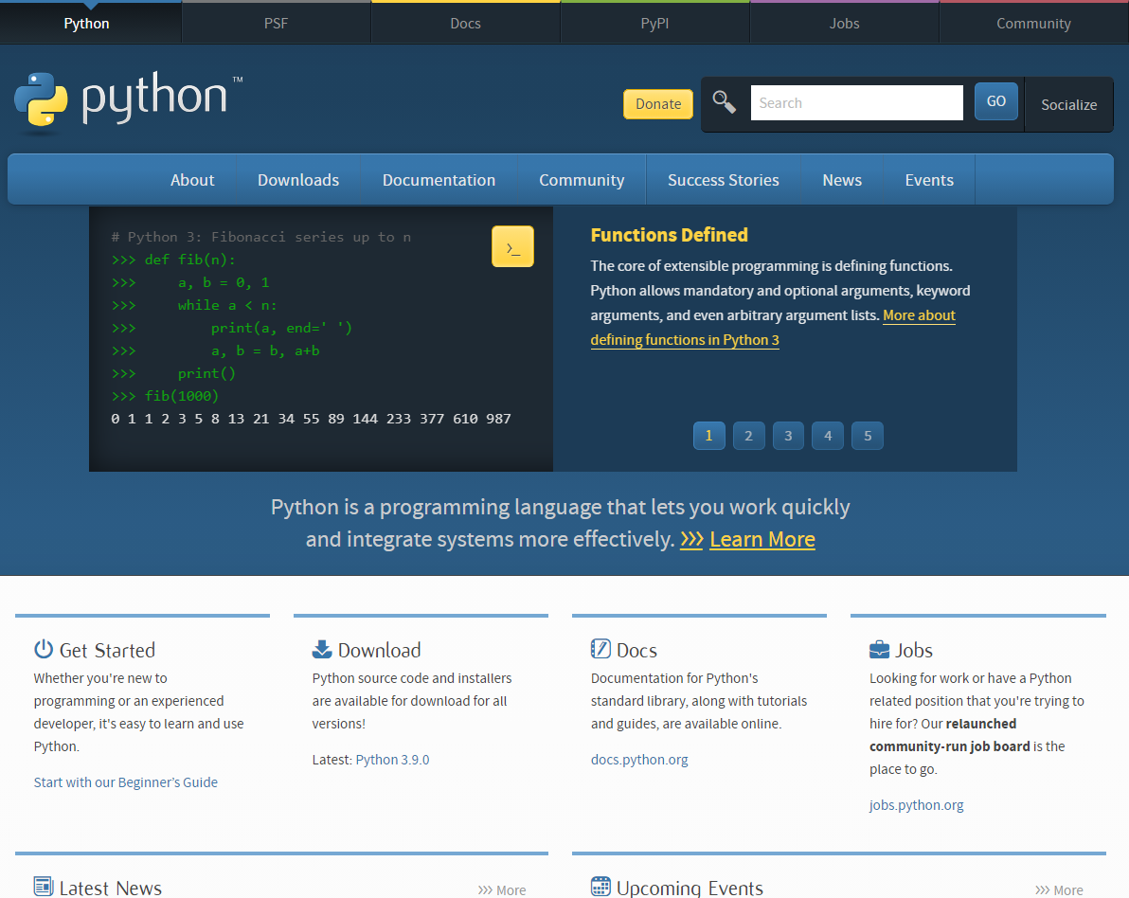
Presentation Layout
python.org
Slides, Github, Youtube provided
Self-introduction
What is Python & Syntax
Why learn Python
Python & Other Languages
Running Python
Python Strings
Python Functions
Python Classes
Starting OOP Concepts
Resources
Action Steps
Closing

Slide 3

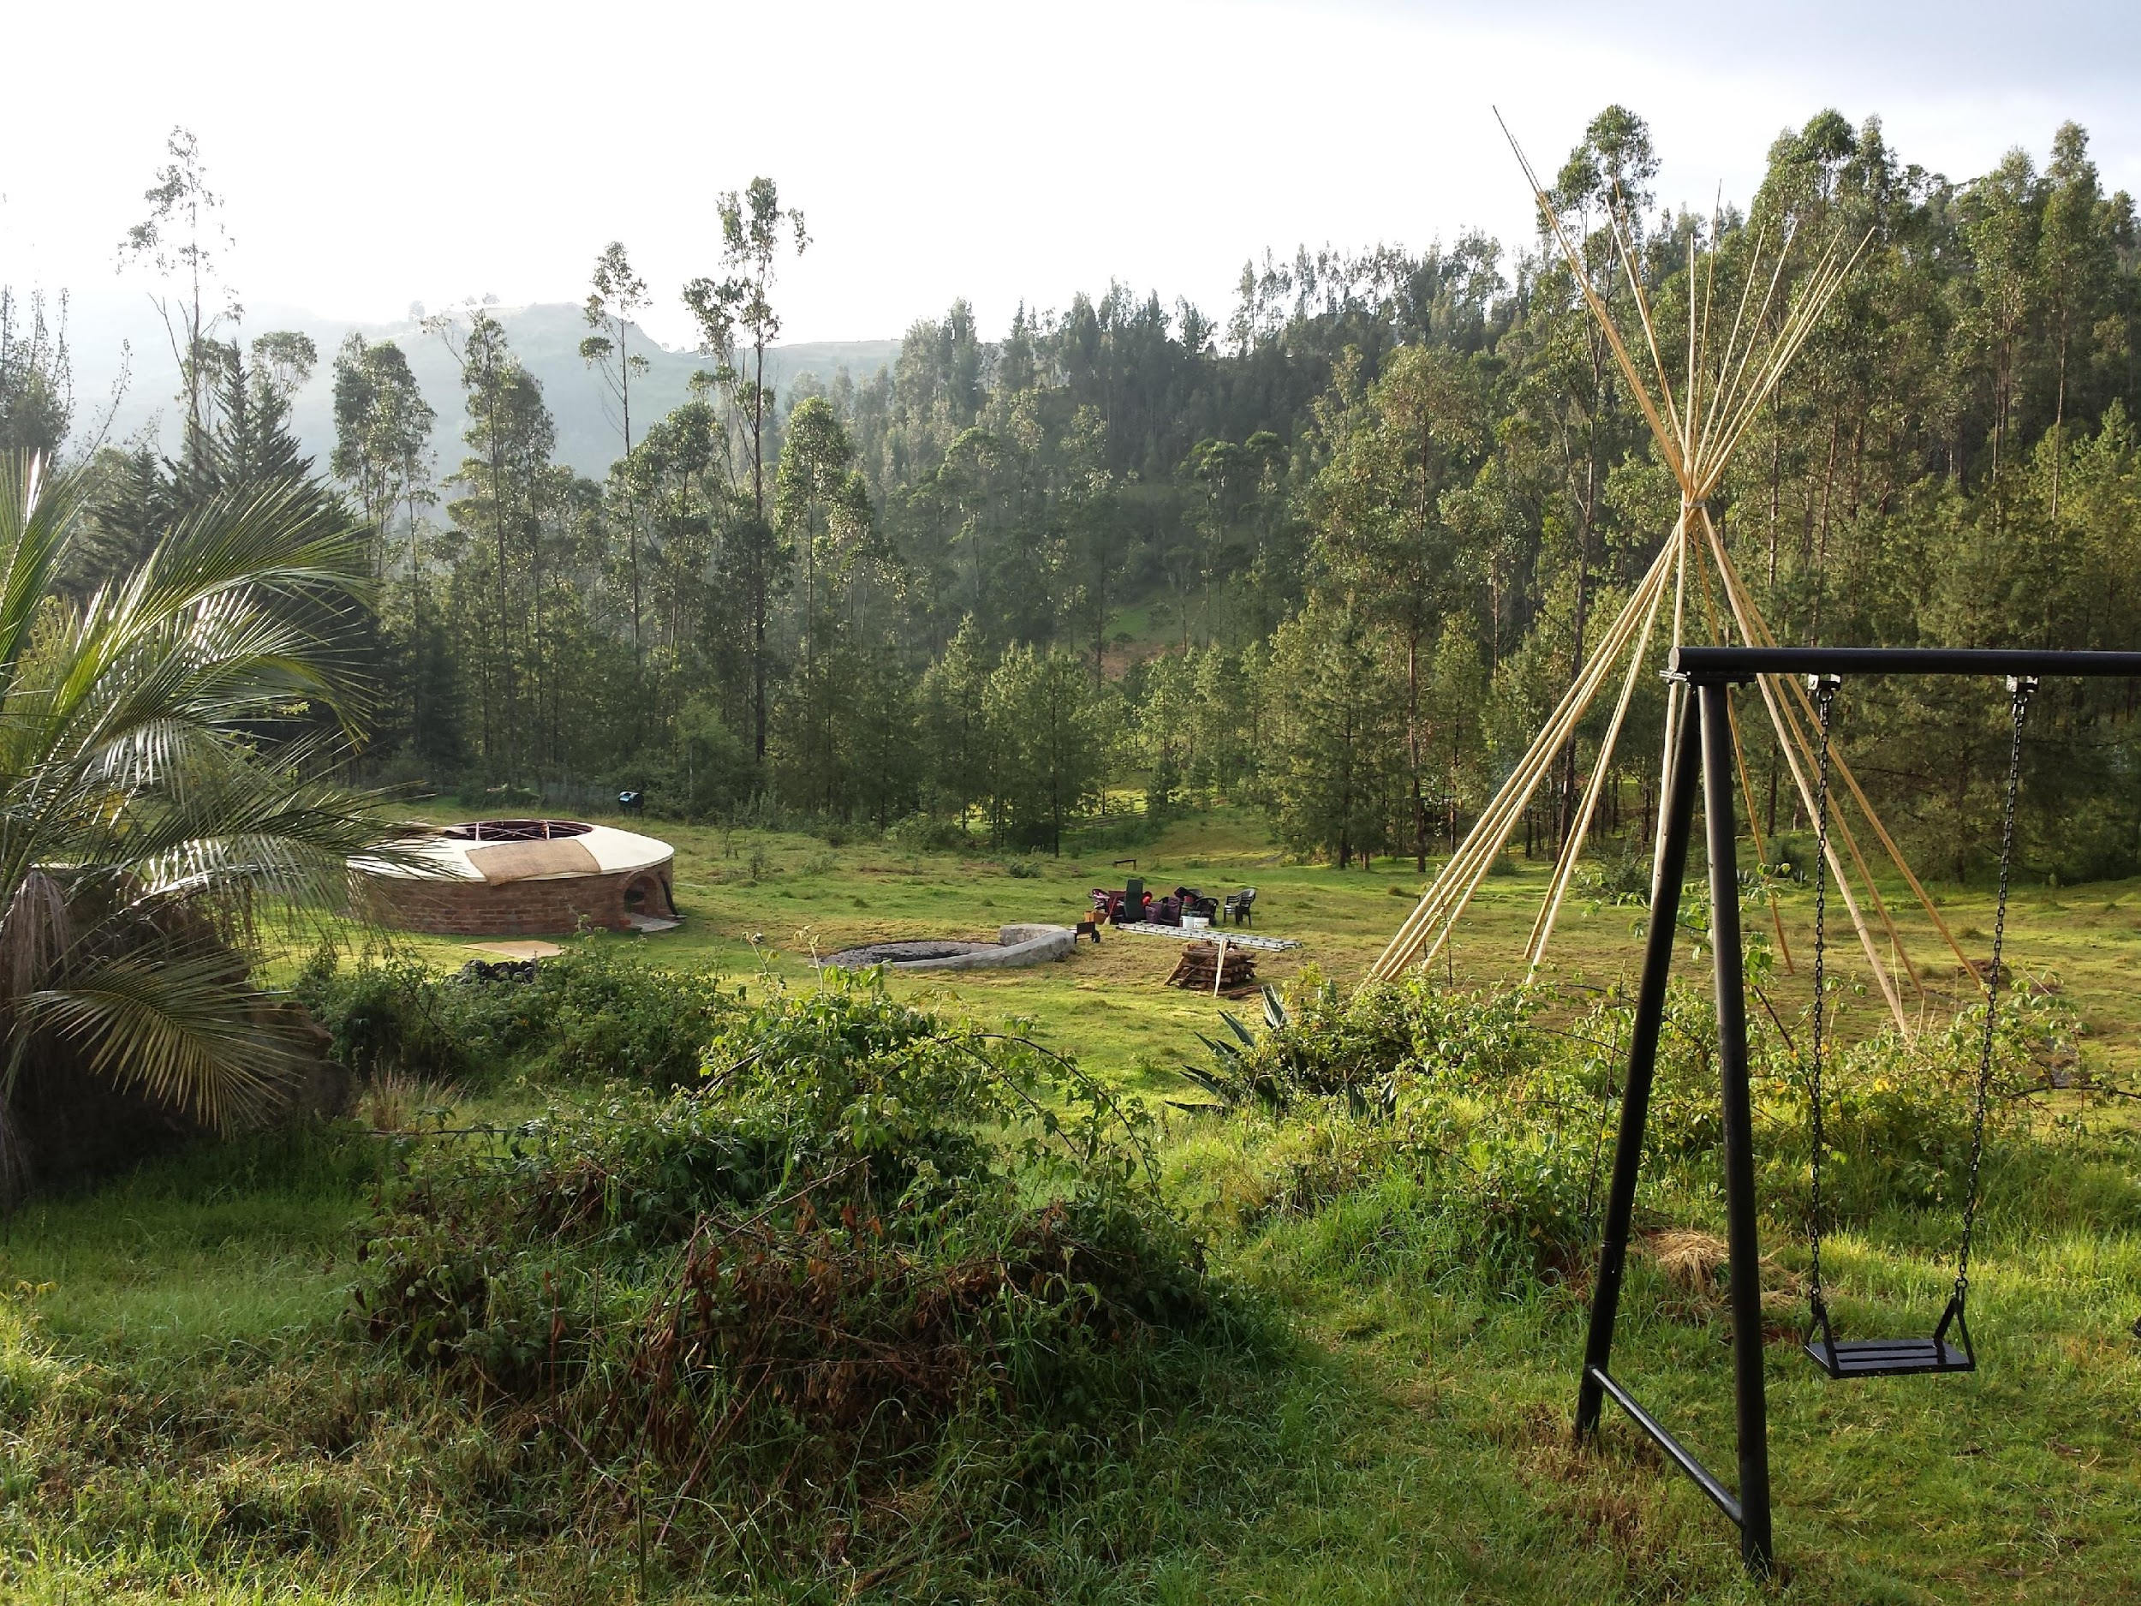






Self-Introduction
Web applications developer
Previously, pharmacist
Previously, Lambda School
I like coding, cryptocurrency, and traveling!

Slide 4
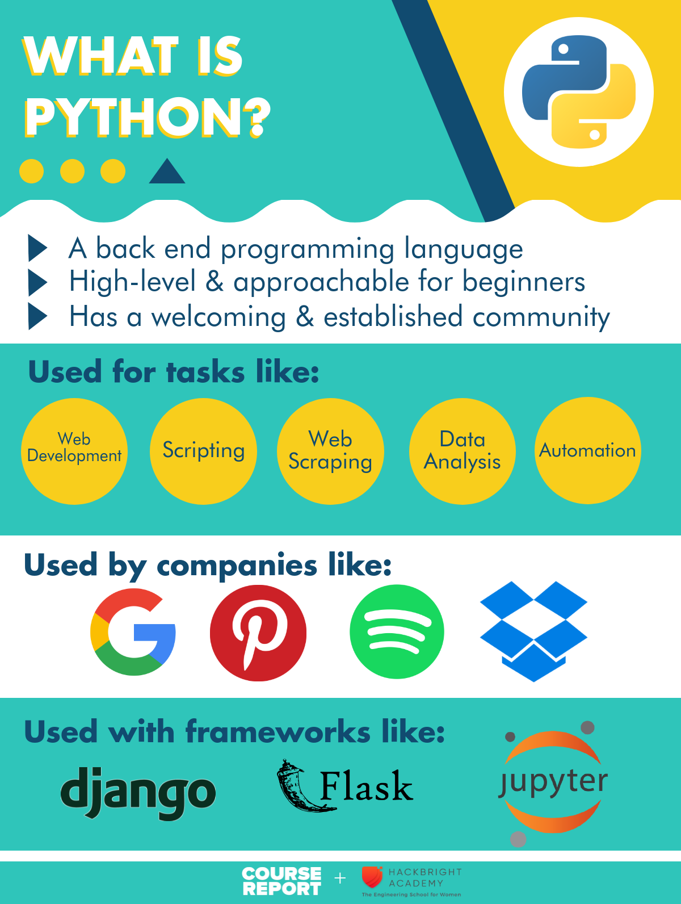

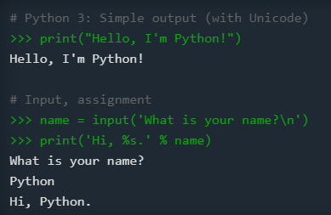
What is Python
Object oriented, back-end language
Simple language for rapid development
Released in 1991 by Guido van Rossum
Name from being “a big fan of Monty Python's Flying Circus”
Most recent version is Python 3
Python 2 is still popular, end of life on 1/1/2020
wikipedia.org
python.org
coursereport.com

Slide 5
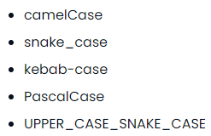
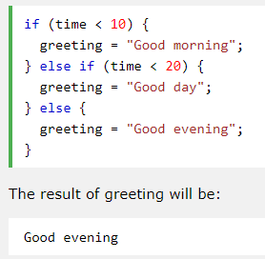
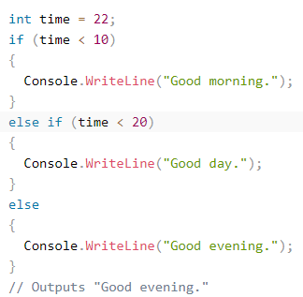
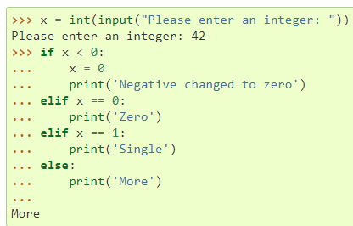
What is Python Syntax
Uses lines and indentation, instead of semicolon or parentheses
Focuses on object/classes, has members and methods
“Partial” OOP language with concepts like APIE (abstraction, polymorphism, inheritance, encapsulation)
Uses PEP-8 style guidelines and snake_case typing
chaseadams.io
Python
JavaScript
C#
docs.python.org
w3schools.com
w3schools.com

Slide 6

Why Learn Python
Simplicity, readability, and easy to learn (Zen of Python, use import this)
“Batteries included” language with large standard library
Supports modules for extensibility
Large community, established knowledge base, open-source
Used in web development, data analysis, scientific computing, machine/deep learning, internet of things
Works on many platforms (Windows, Mac, Linux, Raspberry Pi)
Supports many paradigms: procedural, object-oriented, or functional
Web Development Frameworks: Django (2005), Flask (2010)
Has garbage collection. Yay!
flask.palletsprojects.com

Slide 7

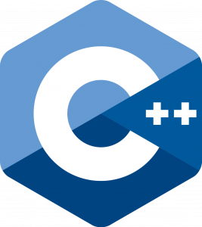


Top 5 Languages 2020 from hackr.io
Python and Other Languages
One of the more well-known languages
Use the language that best suits your purpose
Consider frameworks and libraries on top of these languages
Looking for a job? Google for top languages of <current year>
Web development? Try JavaScript (React, Node, Electron, React Native)
Game development? Try C++
Enterprise applications? Try Java or C#
Language closer to the hardware? Try C
Data Analysis/Machine Learning? Try R
Aiming for Google? Try GoLang
Blockchain/Cryptocurrency? Solidity or Plutus

Slide 8
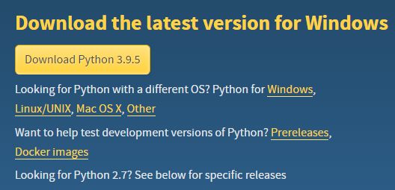
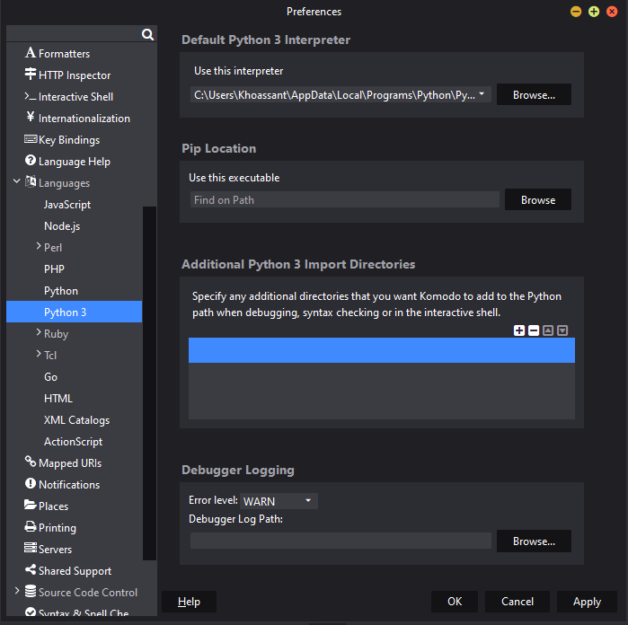
python.org
Running Python
Python 3.9.5
IDEs: Thonny, Komodo, and PyCharm
1.Downloaded Python 3.9.5 for Windows
2.Downloaded Komodo IDE
3.Registered for free Active State account
4.Run Komodo and choose debugger: python.exe
5.Run python in the terminal
6.Check out the Python Docs and Resources
Choosing Komodo debugger
docs.activestate.com

Slide 9
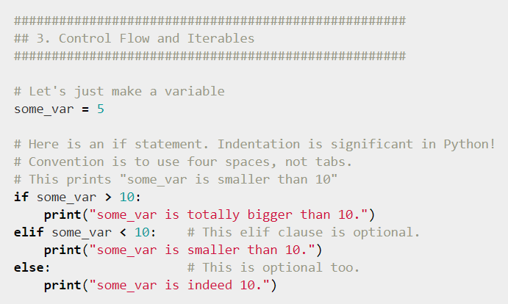
Running commands
7.Try Py terminal commands
py - runs the py terminal
import this - runs the Zen of Python
Shift enters makes a new line
Enter submits a line
exit() - exits the py terminal
cls - clears the windows terminal
Try an if-elif-else loop
Try a li = [] (list) and use li.append(), len(li), li.pop() and looping through a list
Try importing the math module (import math) and use math.pi, math.ceil, math.floor
8. Use X in Y Minutes to learn more language syntax
learnxinyminutes.com

Slide 10
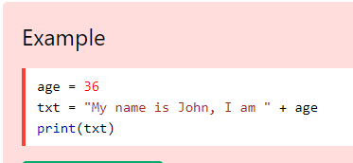
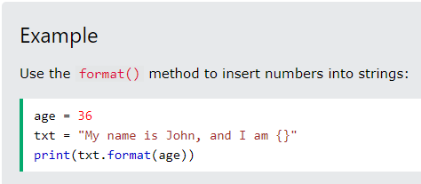
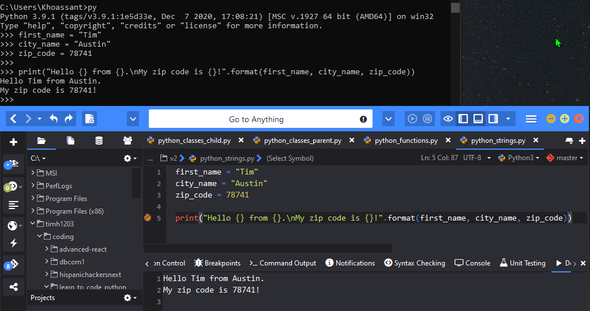
Tip: Can’t add numbers to strings unless you use .format()
Code Example #1: Strings
Strings display info and helps with debugging
Old way to write strings (line 5)
“\n” is a line break. (line 5)
Terminal introduction
Komodo introduction
See github repo for code
Tip: Create a new file with the Python3 template.

Slide 11
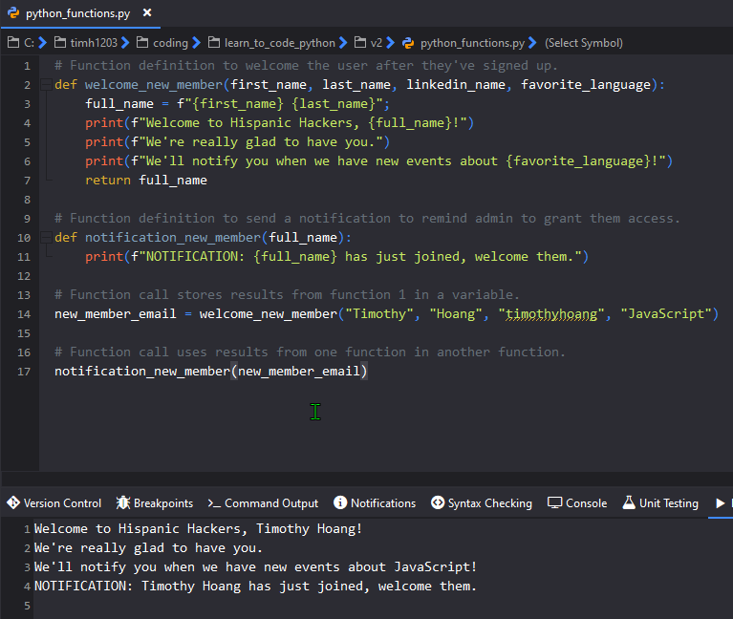
Code Example #2: Functions
Imagine a backend app...
Welcome new members
Send admin a reminder
Store member name in variable to use in reminder function and possibly grant permissions
Definitions declarations (2,10)
Definition Calls (14,17)
Tip: F-strings or formatted string literals is an easier way to write strings. (lines 4, 5, 6, 11)

Slide 12
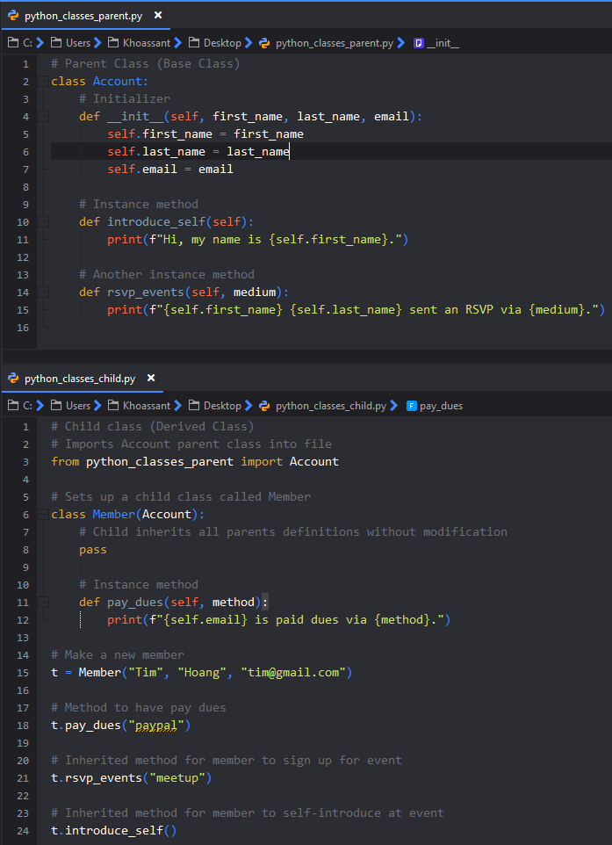
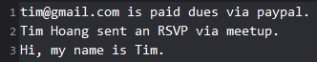
Code Example #3: Classes
Use Inheritance when working with classes
Set up a parent class called Account
Properties: first_name, last_name, email
Methods: introduce_self, rsvp_events
Set up a child class called Member
Receives all properties and methods from parent
Use pass to inherit without modification
Own method: pay_dues
Results:

Slide 13
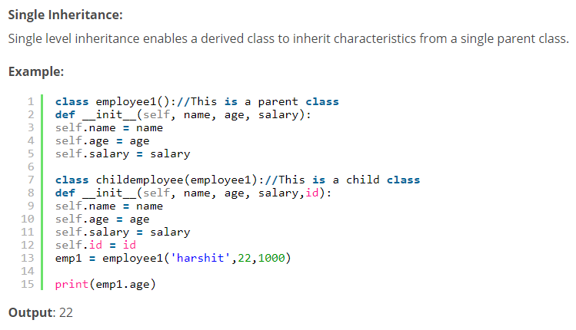
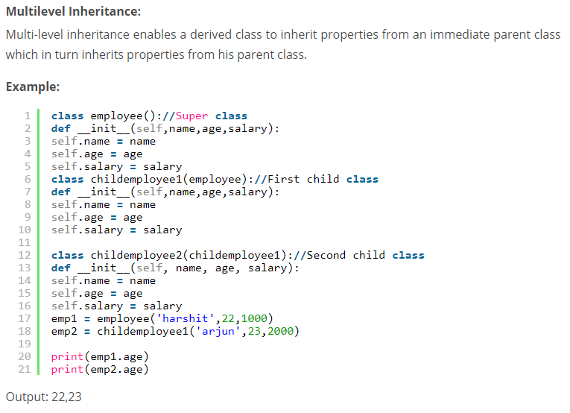
Getting into OOP Concepts
Use OOP concepts in Python
A PIE mnemonic Abstraction, Polymorphism, Inheritance, Encapsulation
Python has single and a variety of inheritance
Multilevel Inheritance Gparent => Parent => Child
Hierarchical Inheritance Parent => Siblings
Multiple Inheritance Dad & Mom => Child
Edureka.co

Slide 14



Getting into OOP Concepts
I did the I in APIE, I’ll leave you to go ape on APE.
Polymorphism
Methods under the same name
Compile-time, static polymorphism, method overloading
Different objects can have different fxn’s with same name
Run-time/dynamic polymorphism, method overriding
Encapsulation
Restricting access outside a class
No private keyword in Python but can use __ (dunder)
Abstraction
Can’t create class, for inheriting functionalities only
You’re not ready for this one!!!

Slide 15
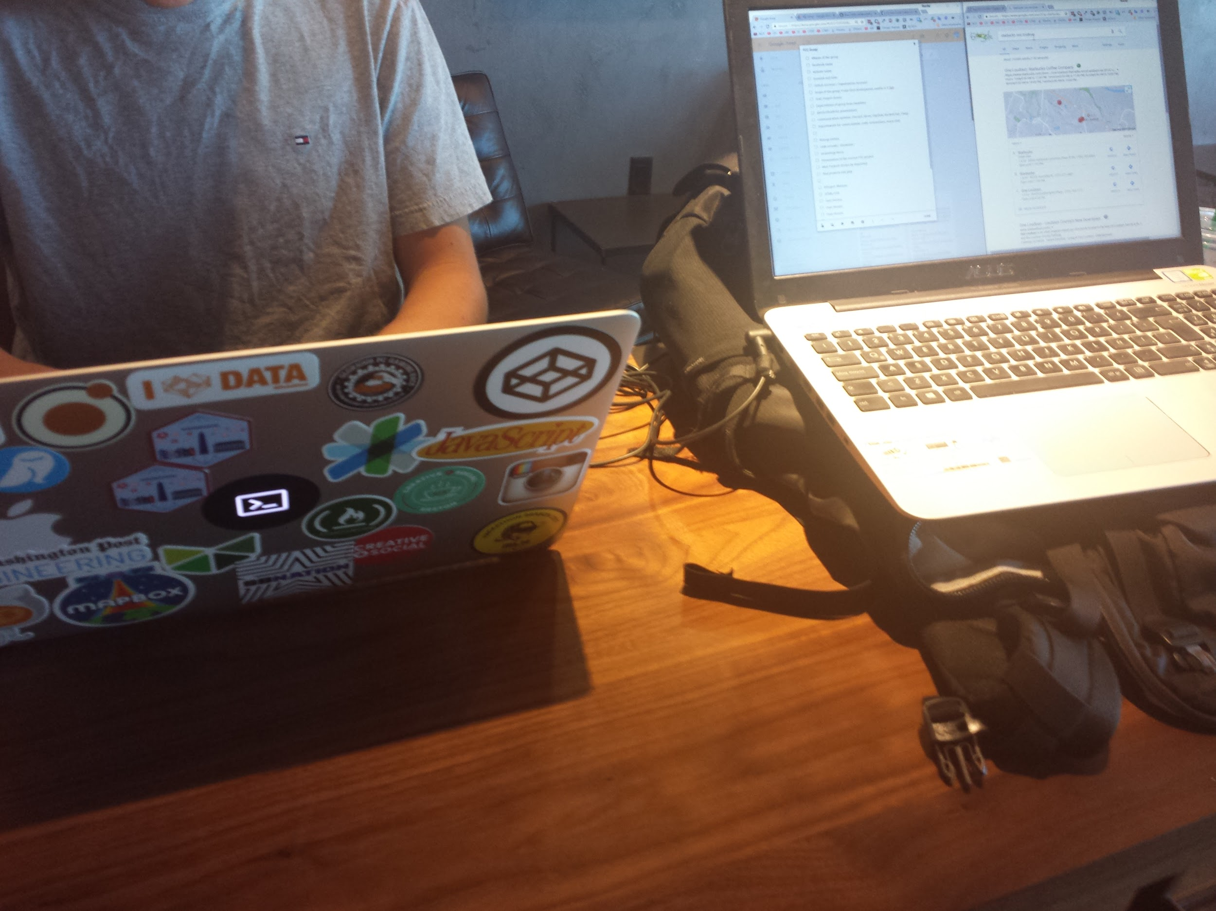
Resources
Official Python
Austin Python Meetup
Python Ecosystem 2020
First presentation with SHPE on 2020-11-12 Youtube
Slides V1 (Nov 2020) PPTX
Second presentation with HH on 2021-5-25 Youtube
Slides V2 (May 2021) PPTX
Github Repo

Slide 16

Sometimes it feels like...
Action Steps
Sign up for a free course
Google’s Python Class
Crash Course on Python by Google
Python 3 Programming Specialization by U of Michigan
Python for Everybody Specialization by U of Michigan
Set up your Integrated Development Environment (Thonny, Komodo, PyCharm)
Set up a github account and version control your code
Build toys and projects as you learn to add to your portfolio
Learn the language deeply, avoid coding polyglotism initially
Learn more tools in the ecosystem and take your skills to the moon

Slide 17

Thanks for your time!
Professional Links
Hispanic Hackers Home
Connect with me professionally: LinkedIn
Personal Links
Thoughts, Code School, Travels
Web Development & Portfolio
DeFi, Cryptocurrency, Finances
Ping me and I’ll send you the links.
Parting thoughts…
Learn in public and share freely.
Always be a student.
Journal more.

